Slide 1

Centralized Application for Program Divisions for Drug Supply Chain

Slide 2

User Role – Program HQ Role
Go-Live In Phase - I
HQ Role
Demand Management | Annual Demand Offline
 | Annual Demand Approval
 | Demand Notification
 | Demand Freeze
 | Annual Demand Staggering
 | Purchase Indent
MSO Procurement | Purchase Order Generation Desk
 | Purchase Order Approval
 | Supplier Interface Desk
 | Challan Process
 | Drug Inventory View
Inventory Management | Release Order Offline
 | Release Order Approval
 | Item Wise Drug Transfer Order
CMSS Integration | RC View
 | Purchase Order View
 | Challan Process View
 | Drug Inventory View
 | Tender View
 | QC View
Annual Demand Offline
Demand
Annual Demand Approval
Annual Demand Staggering
Purchase Indent
MSO Procurement
Purchase Order /Approval
Supplier Interface Desk
Challan Process
Inventory
Release Order Offline
Release Order Approval
Item Wise Drug Transfer Order
Tender / RC View
CMSS
Drug Inventory View
Purchase Order /Challan View
QC Status View

Slide 3
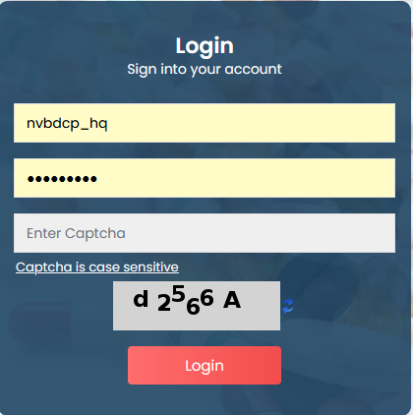
Login Steps
URL: https://dvdmsmscp.uat.dcservices.in/IMCS/login
Username : admin_nvbdcp (HQ level ID)
Password : admin@123
Login with HQ level user
Refresh the captcha

Slide 4
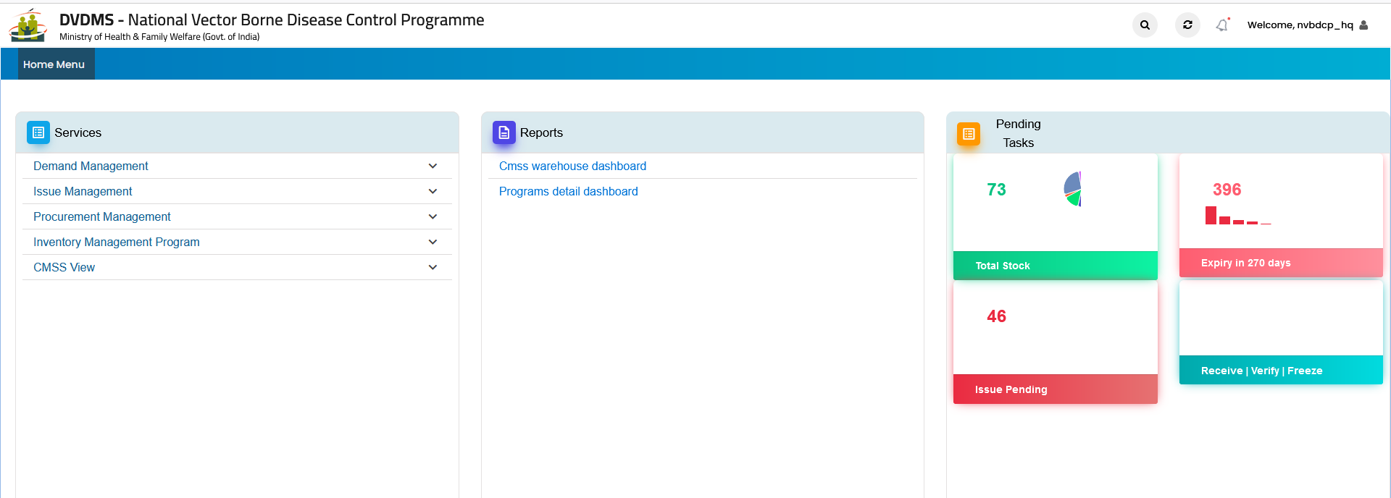
Login Steps

Slide 5
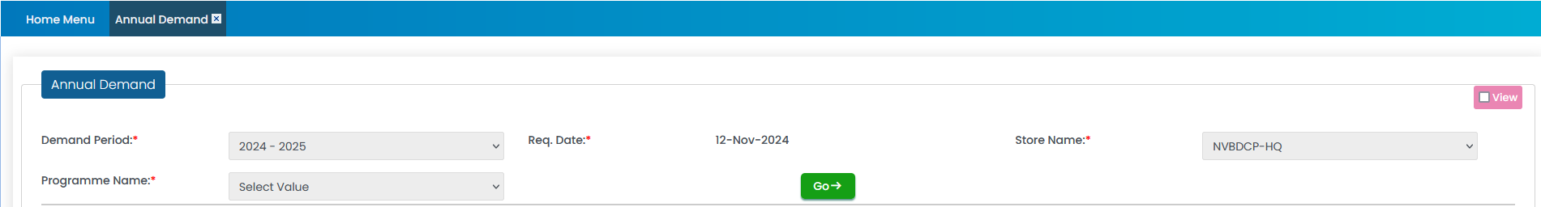
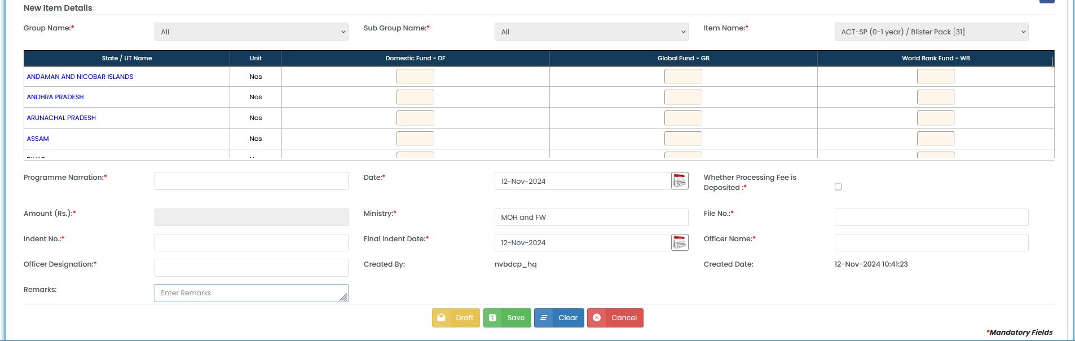
Offline Demand Generation

Slide 6
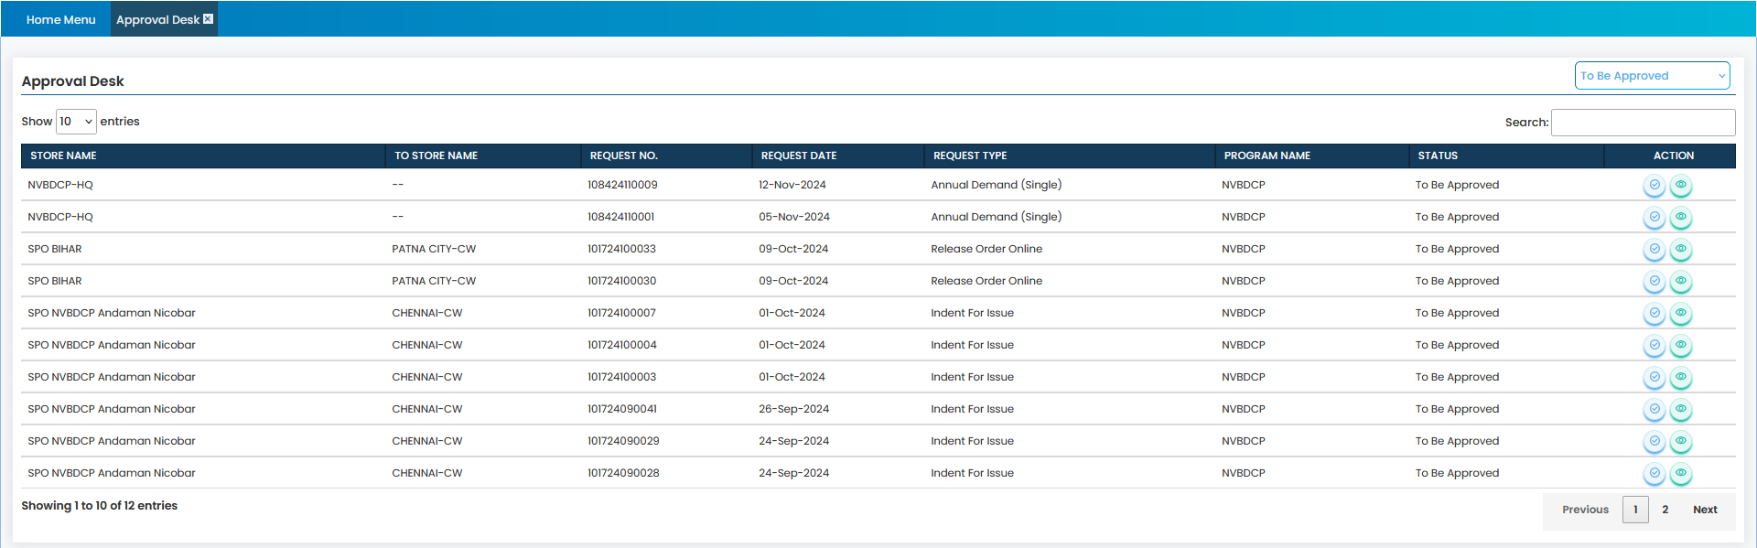
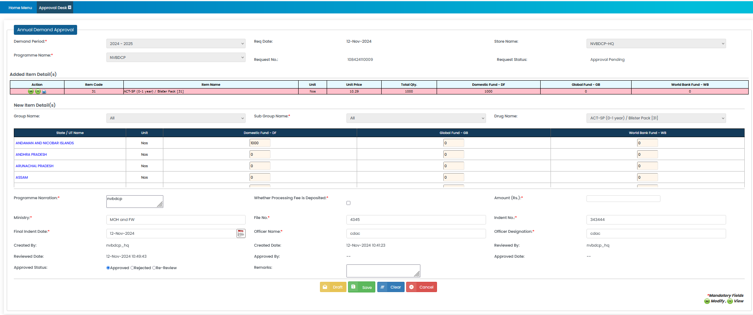
Demand Approval

Slide 7
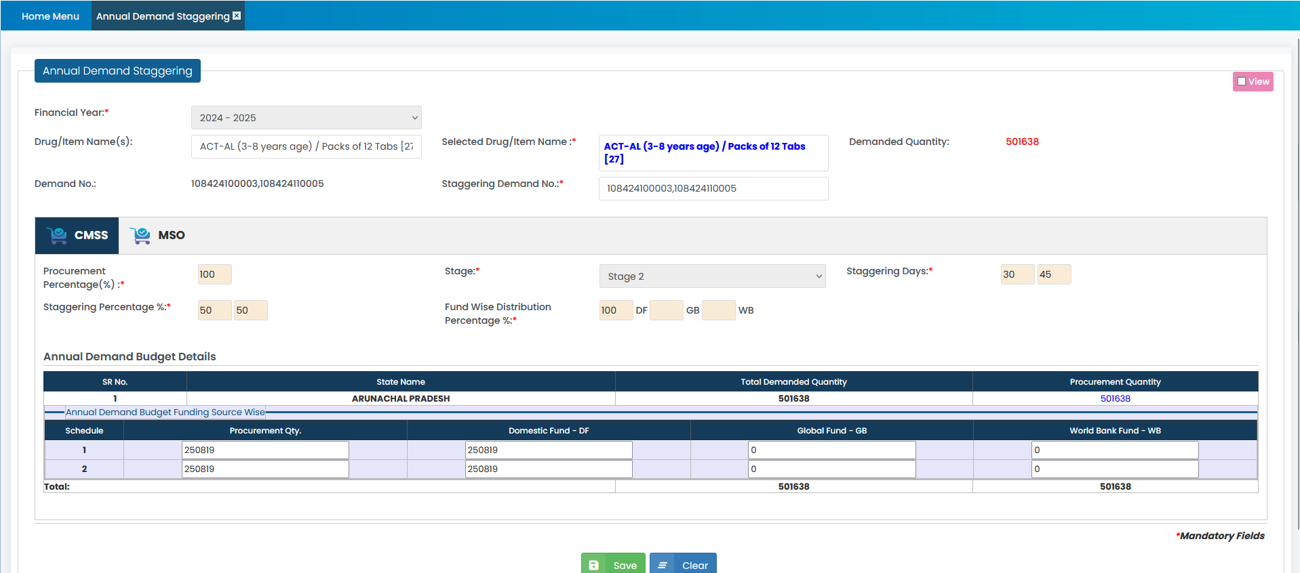
Demand Staggering

Slide 8
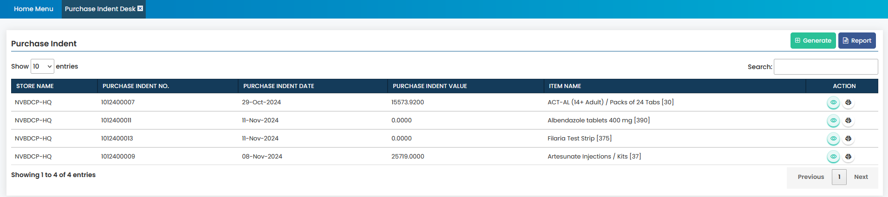
Purchase Indent to CMSS/ MSO

Slide 9
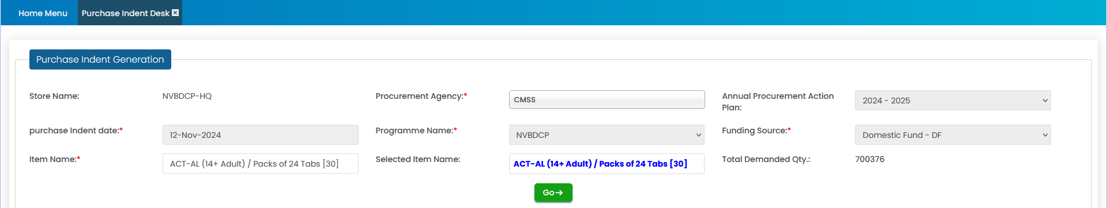
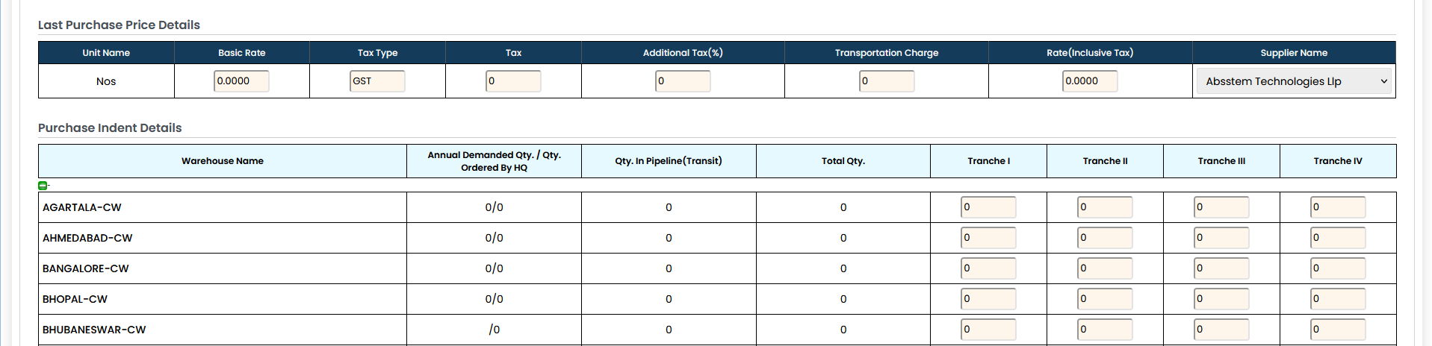
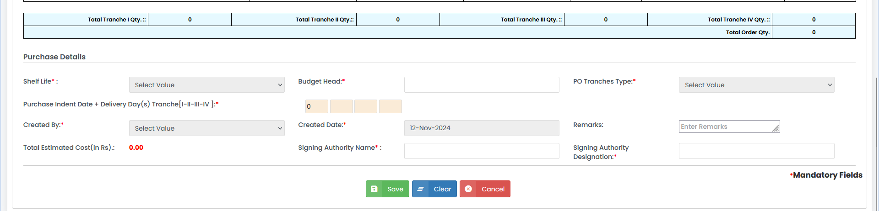
Purchase Indent to CMSS/ MSO

Slide 10
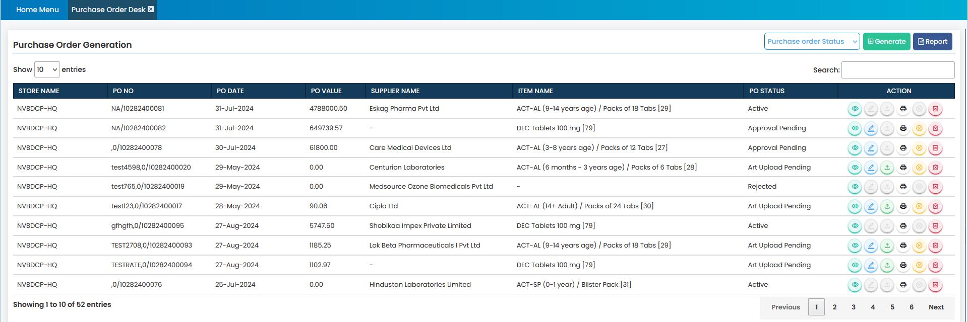
MSO Procurement - PO Generation

Slide 11
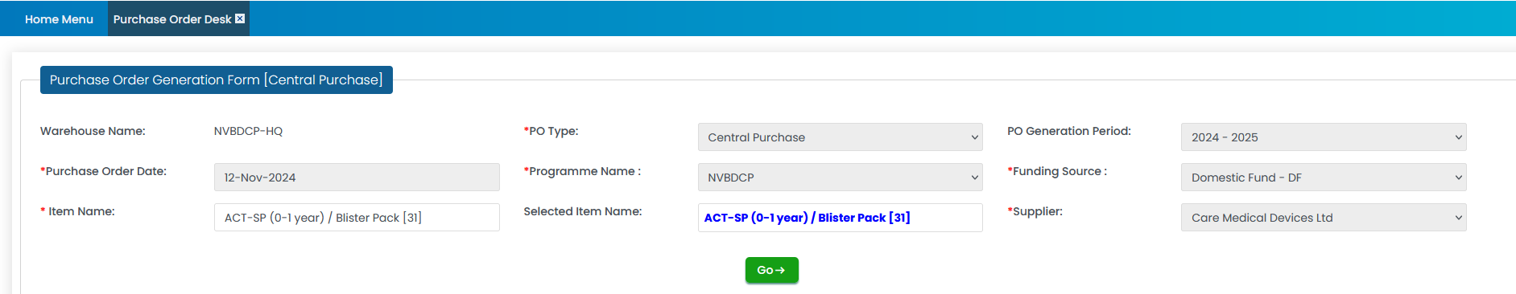
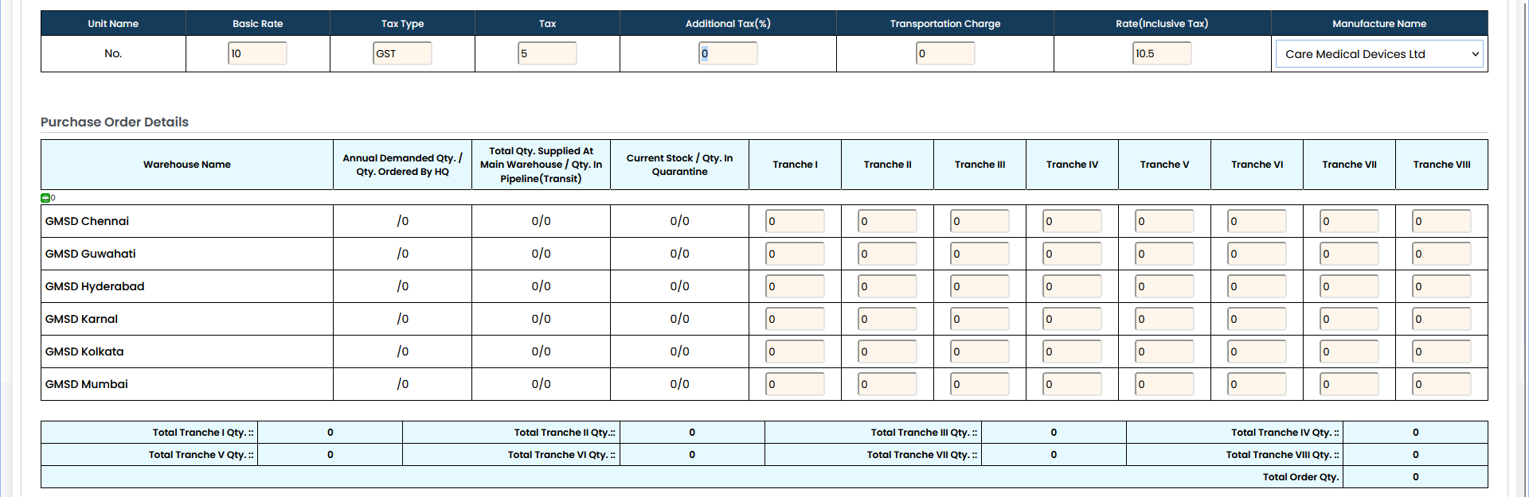
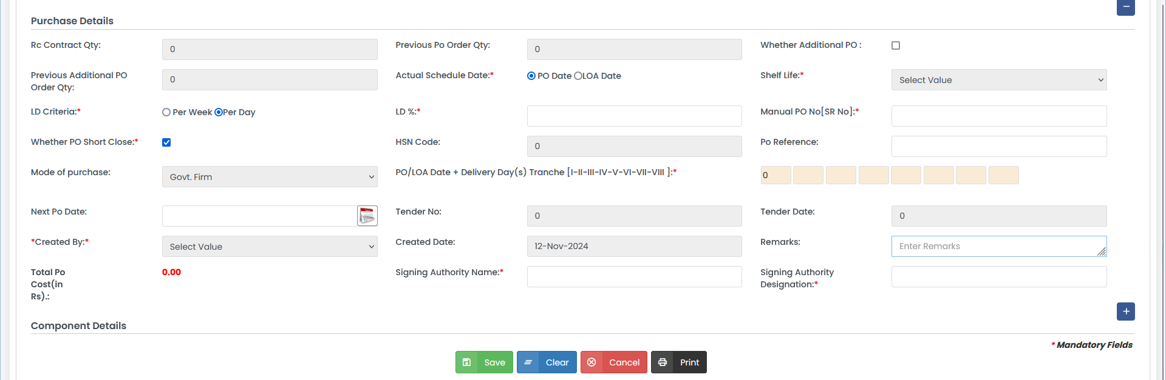
MSO Procurement - PO Generation

Slide 12
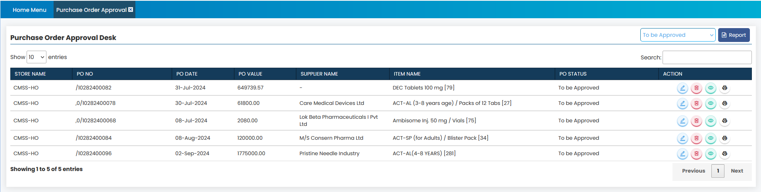
MSO Procurement - PO Approval

Slide 13
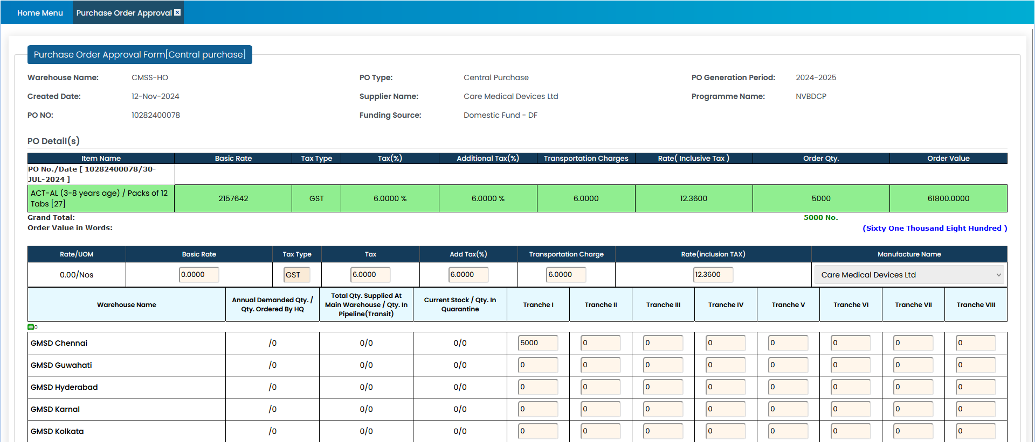
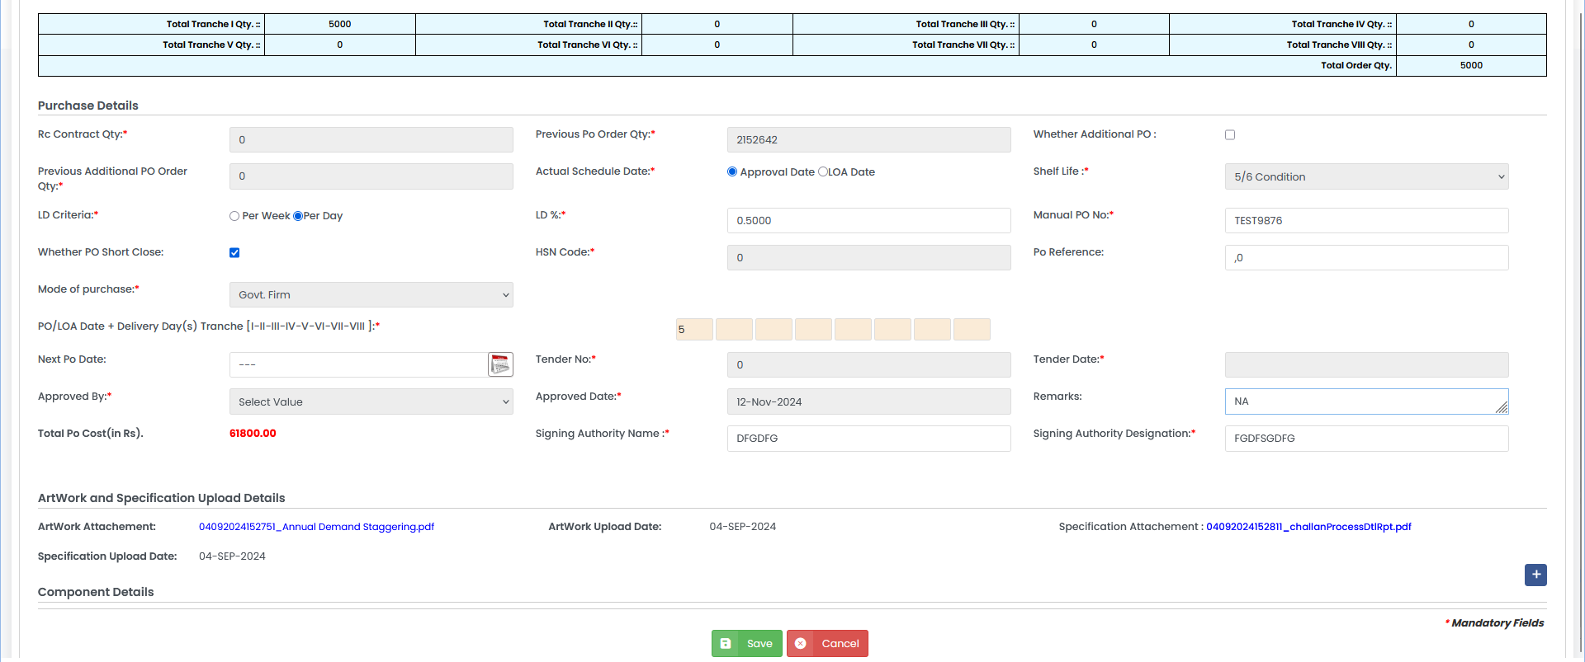
MSO Procurement - PO Approval

Slide 14
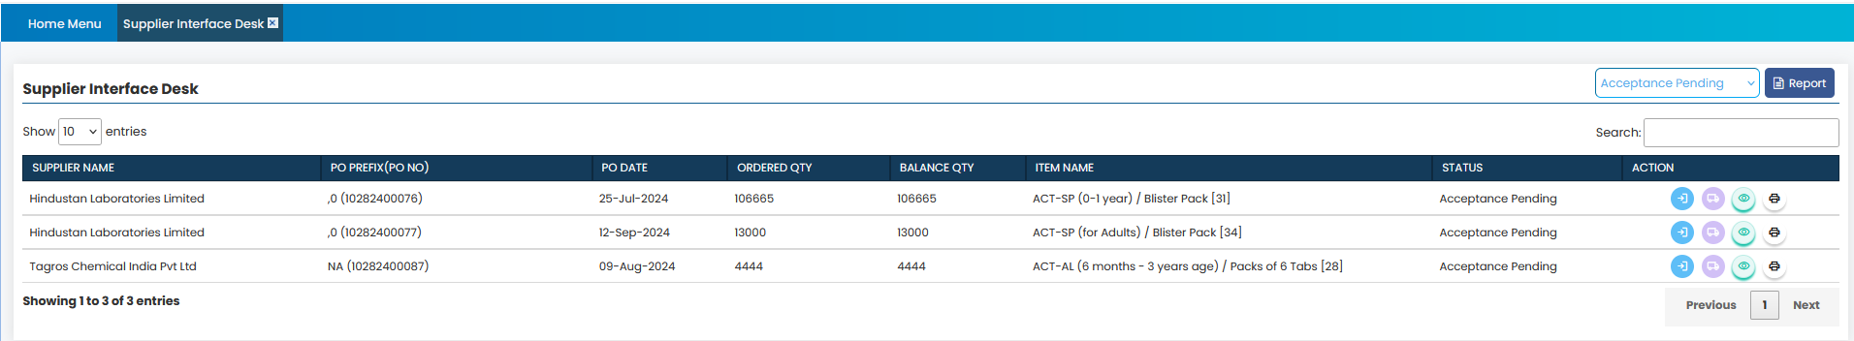
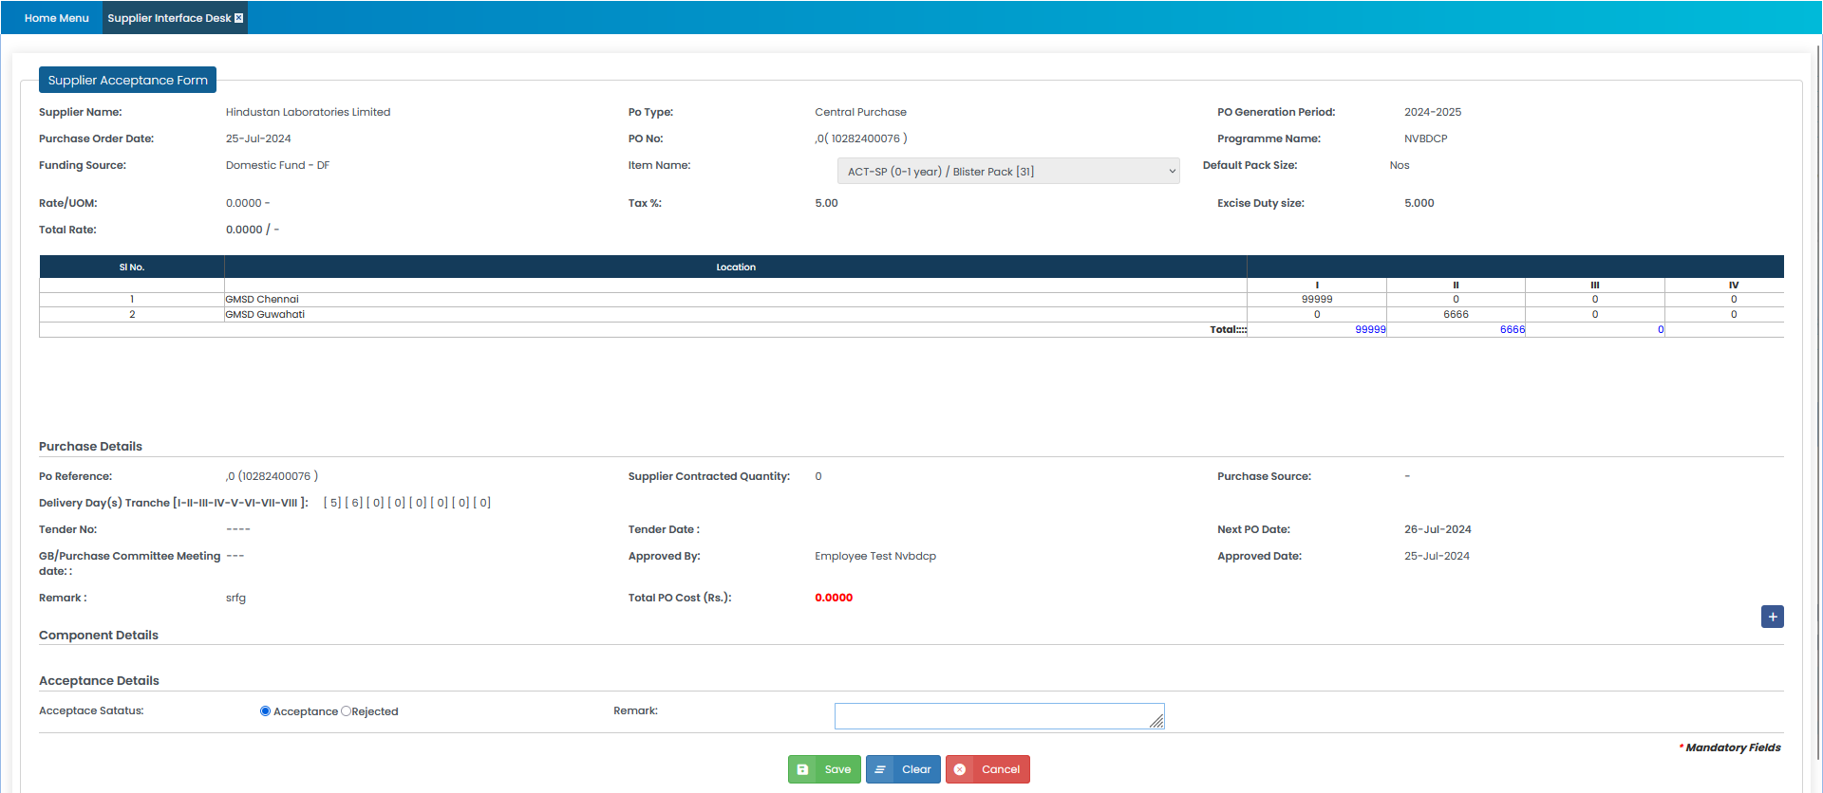
MSO Procurement – Supplier Interface

Slide 15
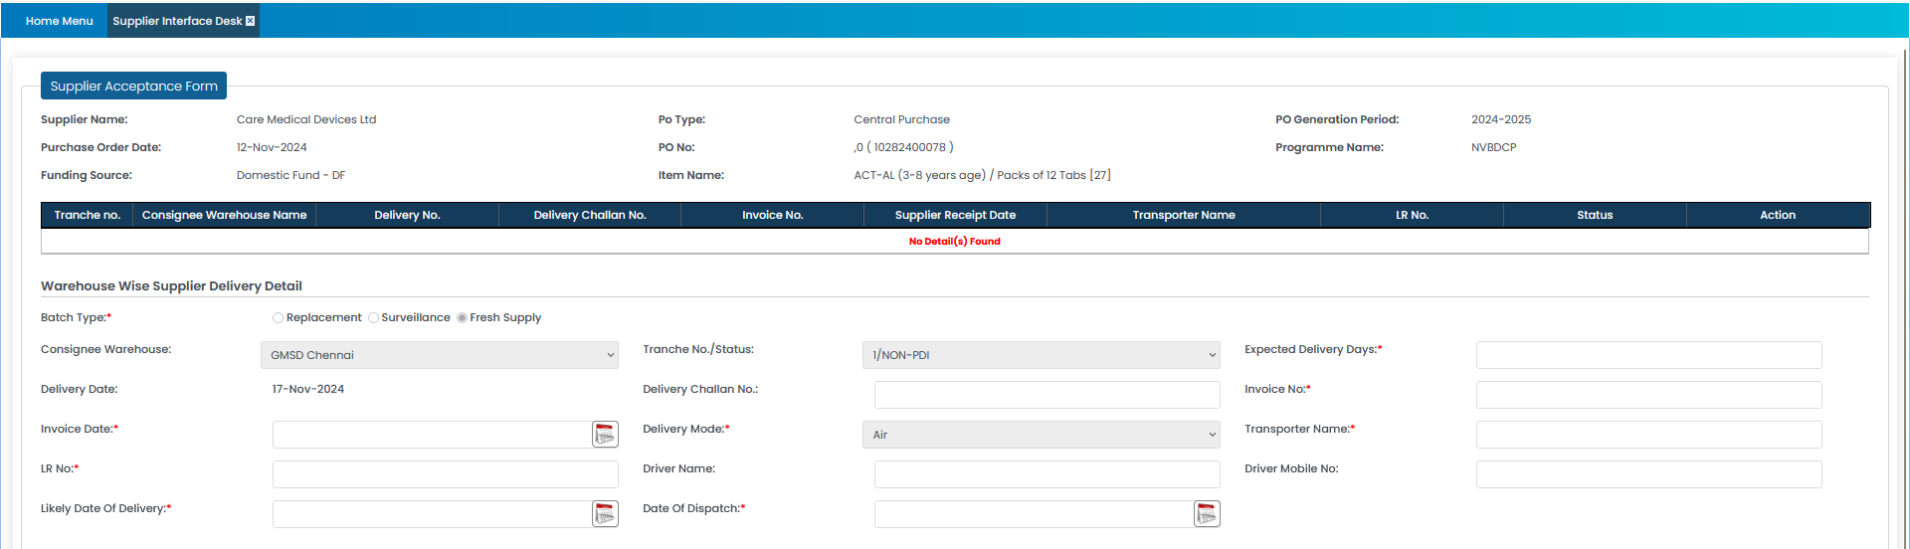
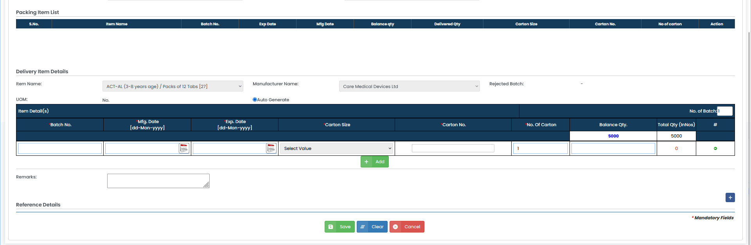
MSO Procurement – Supplier Interface

Slide 16
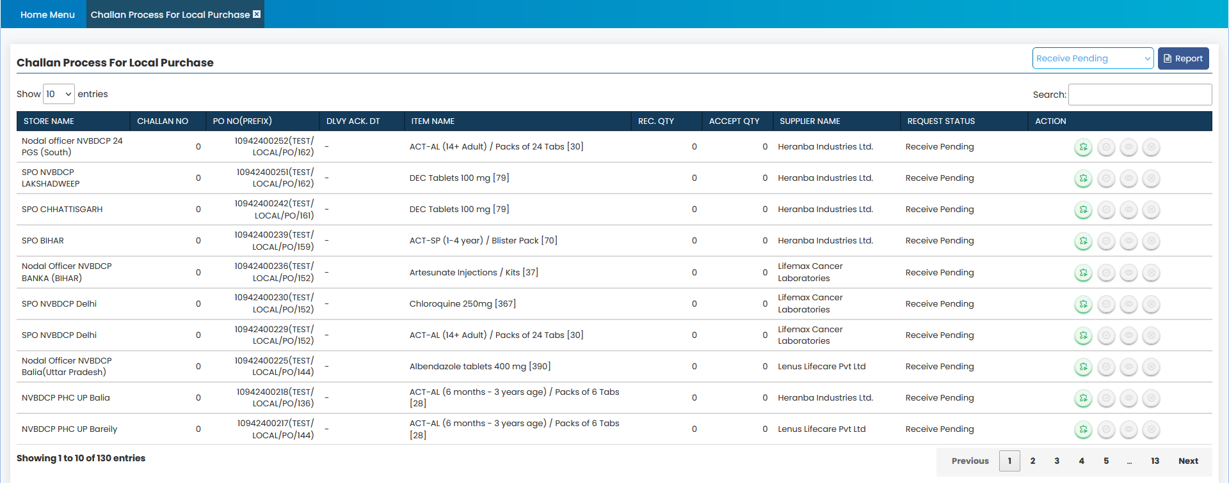
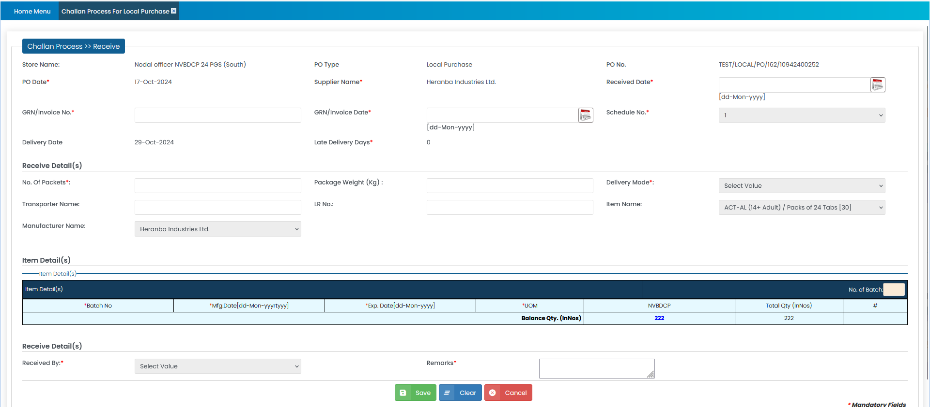
MSO Procurement – Challan Process

Slide 17
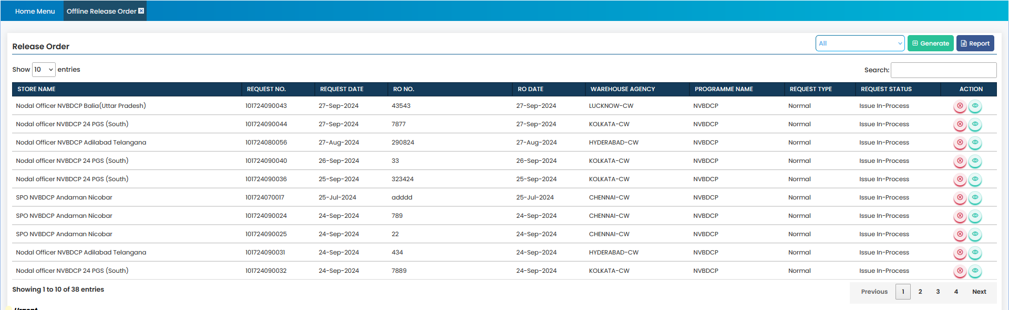
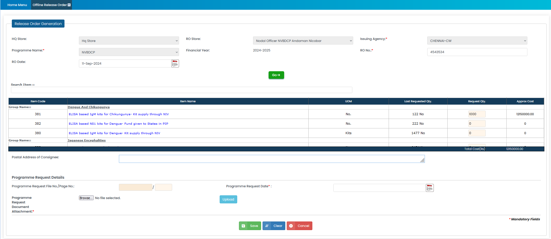
Release Order

Slide 18
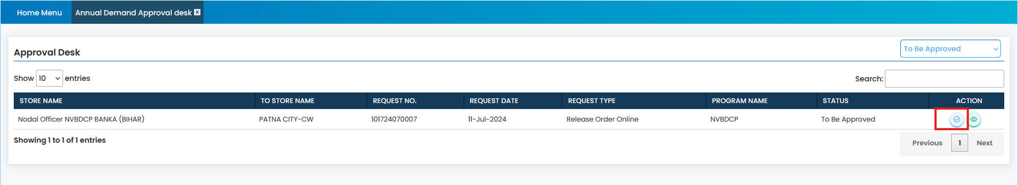
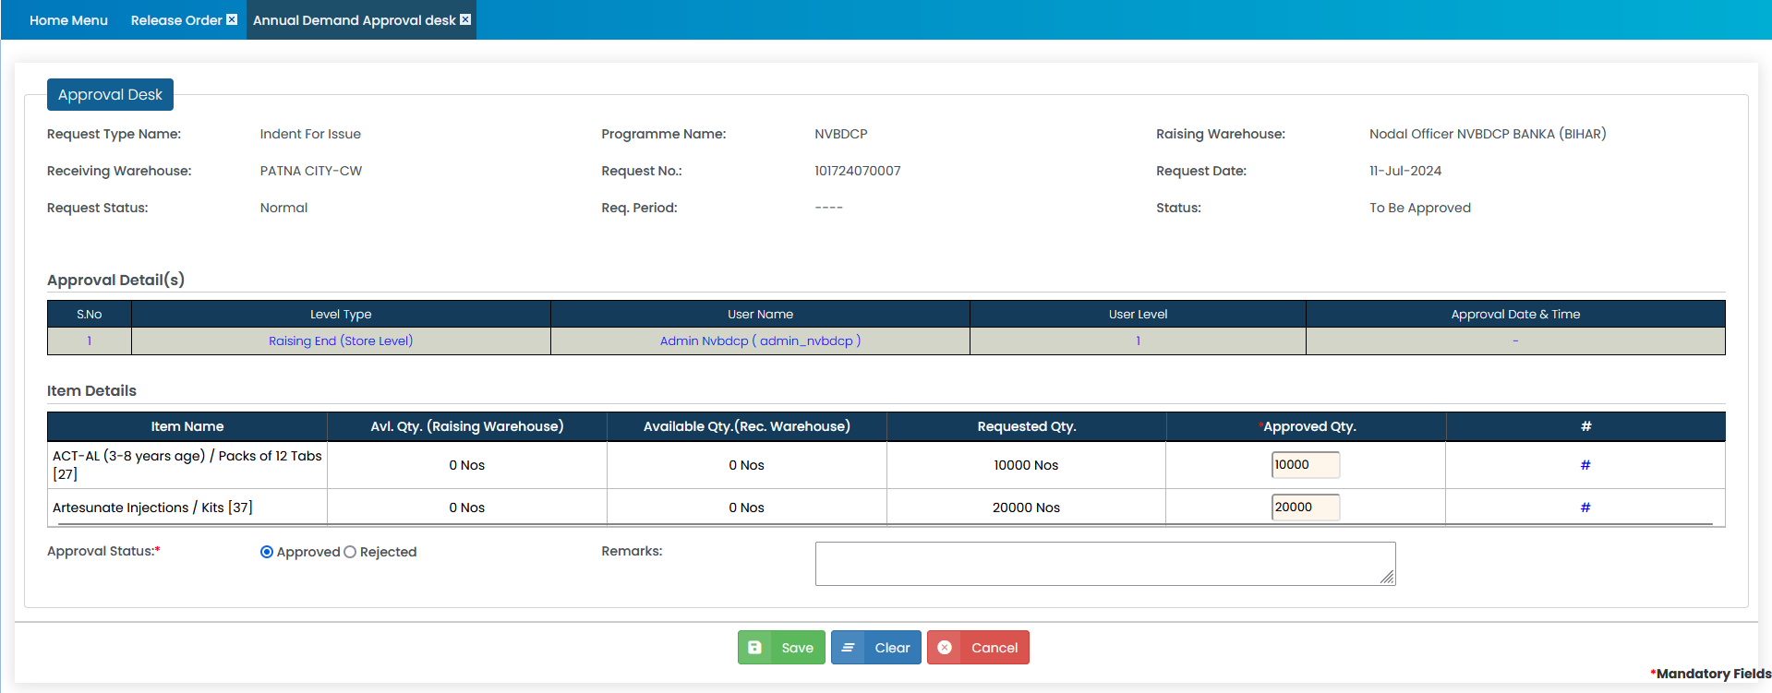
Release Order Approval

Slide 19
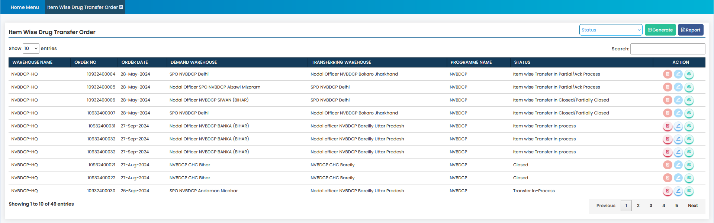
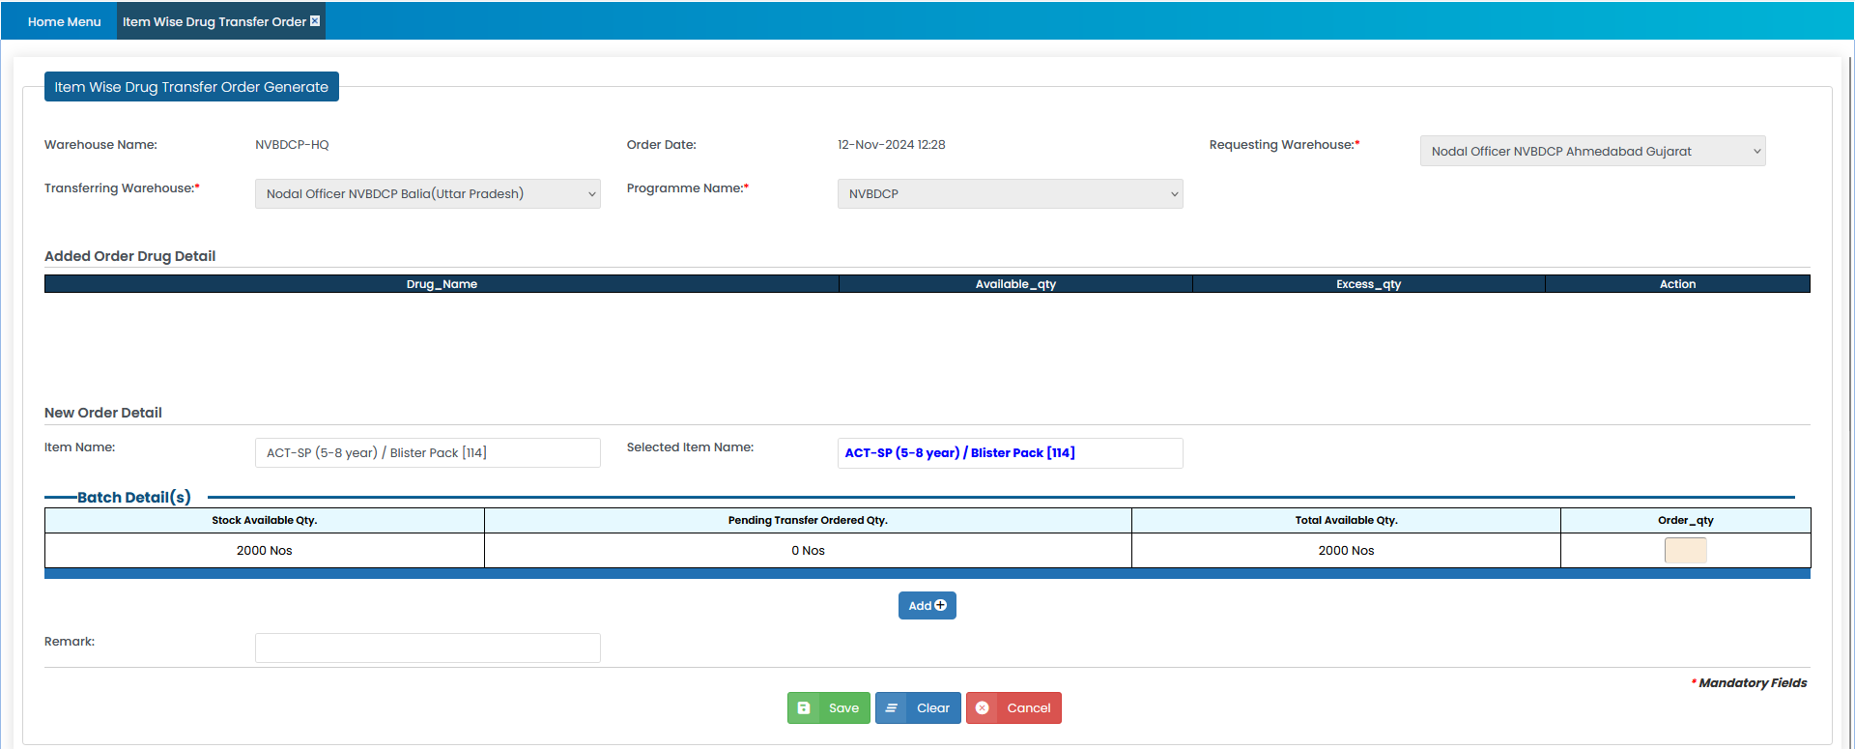
Transfer Order

Slide 20
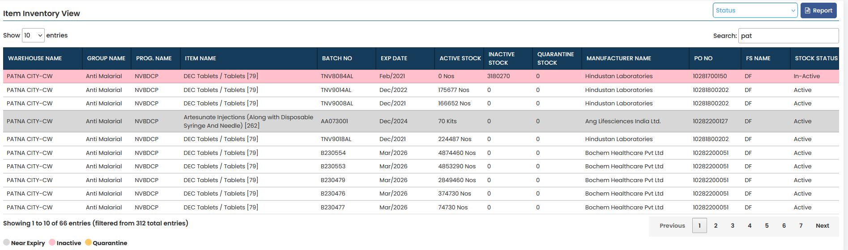
CMSS Stock View

Slide 21
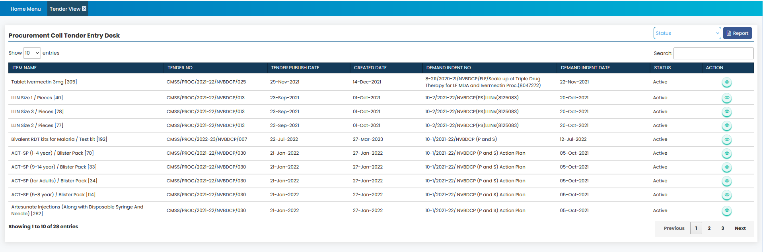
CMSS Tender View

Slide 22
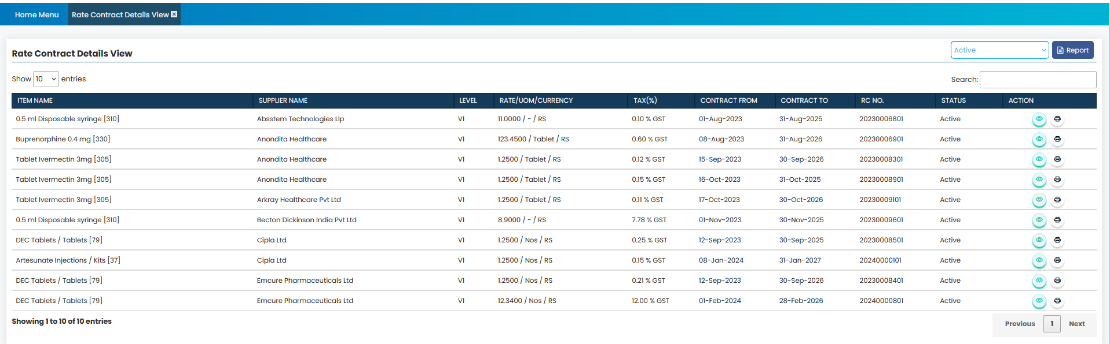
CMSS Rate Contract View

Slide 23
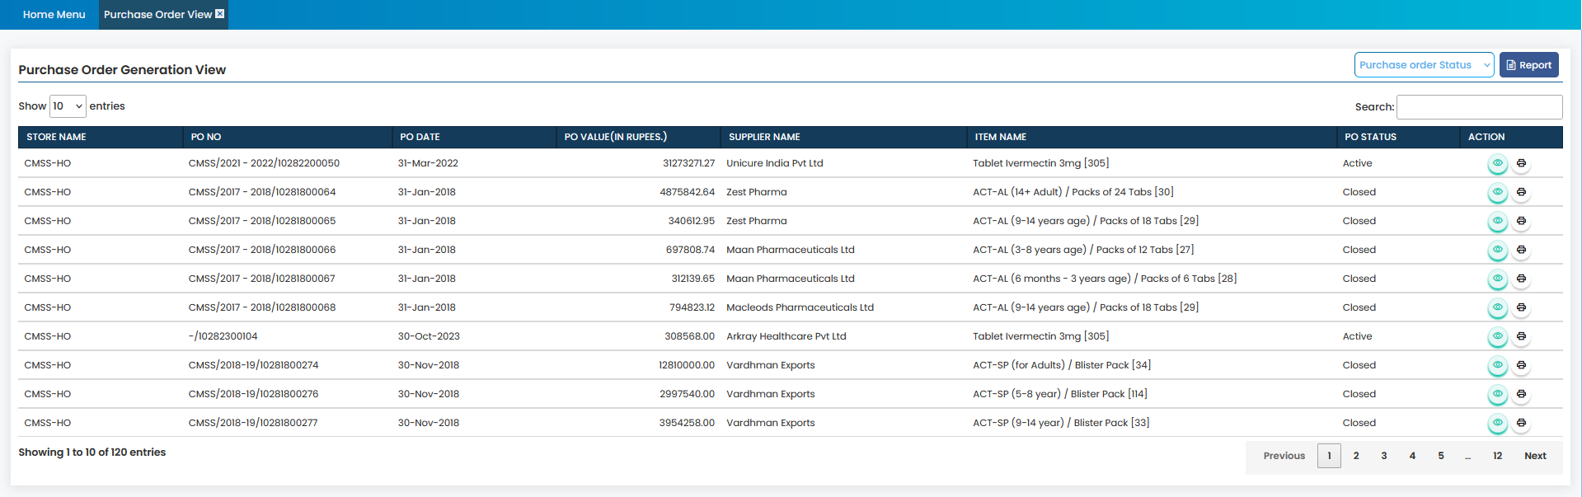
CMSS PO View

Slide 24
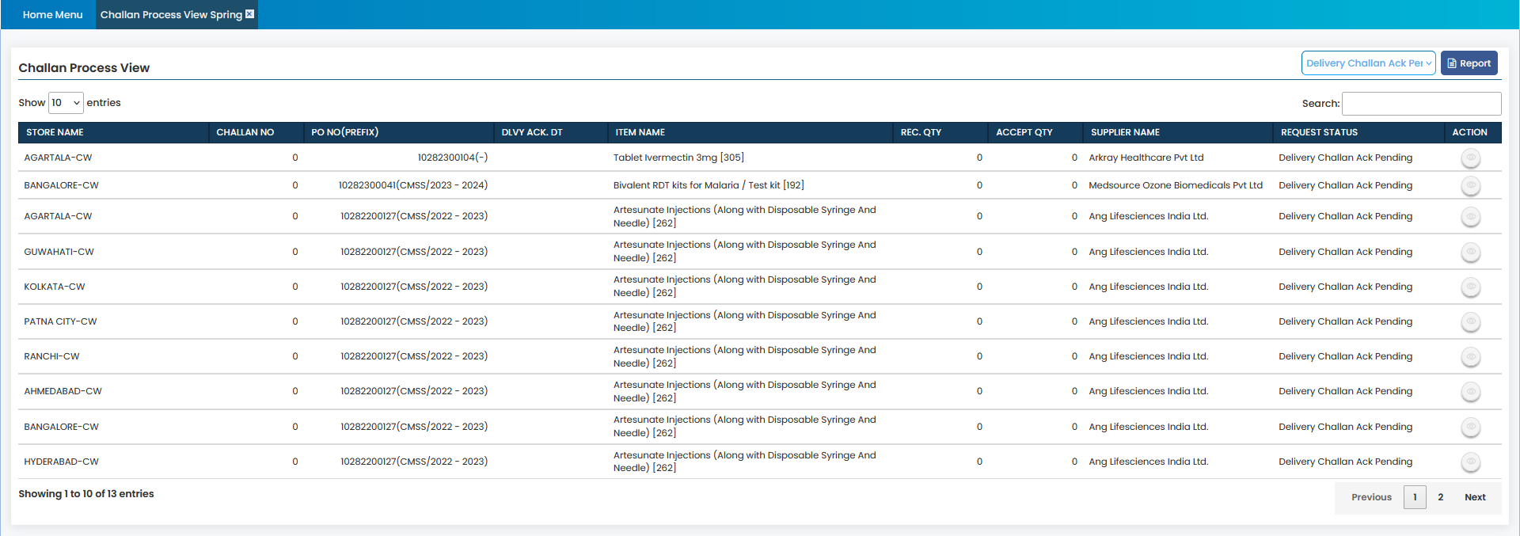
CMSS Challan View

Slide 25
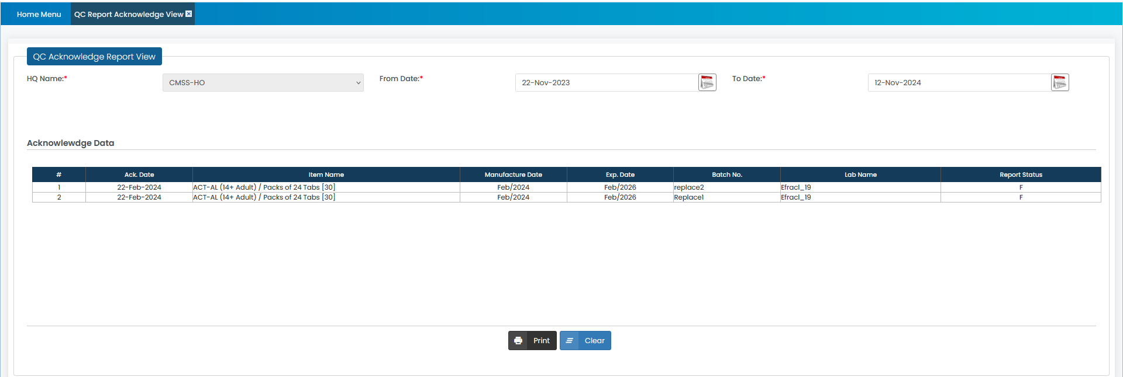
CMSS QC Report View

Slide 26
Thank you

